Slide 1
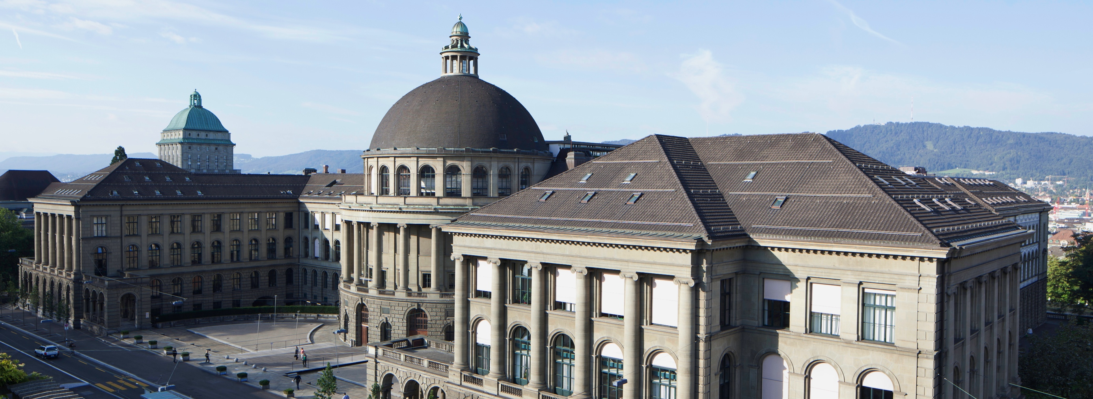
The Second-Order Tocqueville Paradox. How Social Inequality and Class-Dependent Decisions May Dampen Frustration – An ABM. {\textbf{\Large May Dampen Frustration - An Agent-Based Simulation}
Joel Berger, Milan Bombsch & Dai Zhonghuan

Slide 2
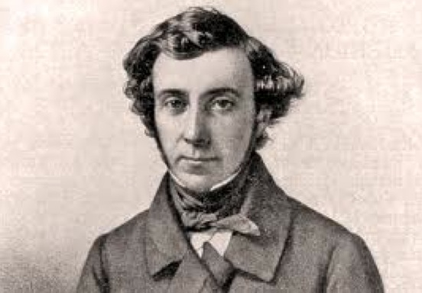
The Tocqueville paradox
Improved conditions, more frustration
Improved social and economic conditions lead to the outbreak of the French revolution (Tocqueville 1856).
Higher chances for promotion – less satisfaction with promotion opportunities (Stouffer et al. 1965)
General question
How is it possible that better opportunities lead to an increase in aggregate frustration in a social system?
Notes:
Joel
Starting point of this project is a historical study by Alexis de Tocqueville.
Tocqueville claims that improved economic and social conditions lead to the outbreak of the French revolution.
Generally, the pattern of more frustration under improved conditions is called the Tocqueville‘s paradox.
Further examples arer the breakdown of the USSR that occured during times of reforms or the overthrow of the Shah in Iran that occurde during times of economic prosperitiy.
A similar phenomenon from a cross-sectional perspective is reported by Stouffer et al. In their study about social mobility in the US army they came to the result that on average, satisfaction with promotion opportunities in a given brach was higher, the worse the objective promotion chances were.

Slide 3
Boudon’s competition model
N actors competing for a scarce and highly valued good.
E.g.: high-prestige position within a firm
Losers: frustrated
(Boudon 1979)
Notes:
Joel
The French sociologist Raymond Boudon suggests a game theoretic model explaining Tocqueville‘s paradox.
In a group of N players, each player can decide whether or not to invest resoureces in a competition for a scarce and valued good such as a prestigious position within a firm. Succesfull applicants get promoted and receive the high payoff alpha.
However, if there are too many applicants, some of them fail to get promodet. They have invested their resources in vain and receive the low payoff gamma. The losers are frustrated. Even though they have invested the same amount of resources as the winners, they get nothing in return.
The third possiblity is not to invest. Non-investors cannot win nor can they lose. Hence they receive the moderate payoff beta.

Slide 4
Boudon’s competition model
Notes:
This is the game matrix from perspective of a player i. If you don‘t invest you geht the moderate payoff beta for sure.
Let‘s say there is only one scarce positions. If you are the only one investing you get promoted and receive the high payoff. However, the more other investors there are, the lower the expected value of the strategy „investing“ becomes.
As long as the expected payoff of „invest“ is higher than beta independently of the number of competitors, it is a dominant strategy to invest, everyone should do so. However, if the expected payoff of investing is lower than beta, each player invests with an optimal probability p, that can be deduced from this formula.

Slide 5
Model extensions 1
Dynamic model and heterogeneous actors
Relaxing the assumption of homogenous actors.
Implementing the model dynamically.
After the first round, social inequality emerges:
In the second round, losers have a smaller and winners a greater endowment than before.
Over the iterations, inequality increases.
Notes:
Joel
We extended the basic model by two features.
First, we relaxed the assumption of homogeneous agents.
By implementing the static model as a dynamical one, the model geenrates social inequality.
The losers of the the first round have a smaller endwoment in the second round while the winners of the frist round are wealthier then before.
Over the iterations, social inequality increass.

Slide 6
Model extensions 2
Class specific decision-bias: parameter c
Empirical regularity: Individuals from higher social strata take riskier decisions in upward mobility than individuals from lower social strata (Breen and Goldthorpe 1997).
Distortion parameter c:
The higher an agent’s endowment lies above the starting value, the higher the probability of investing.
The lower the endowment lies below the starting value, the lower the probability of investing.
Notes:
JOel
An empirical finding of research on social stratification is that individuals from higher classes invest in social upward mobility with a higher probability then individuals from a lower class background.
A rational for this is that people aim at maintaining their social position. The higher the position, the more investment is necessary to reproduce the social position in the next generation.
Thus, as a second model extension, we introduce the distortion parameter c. What c does is the following:
Agents losing in the first round of the simulation invest with a lower than the rational probability while winners invest with a higher than the rational probability.
More generally, the bias c depends on an agent‘s endowment. The higher the endowment lies above the starting value, the higher the probability of investing.
Contrarily, the lower the endowment lies below the starting value, the lower the probability of investing.

Slide 7
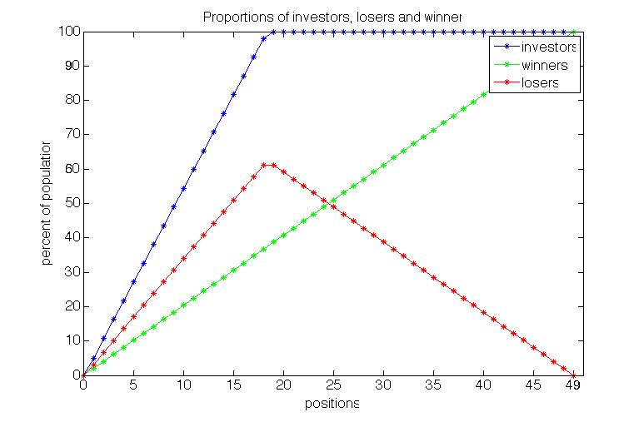
Results: Static baseline model
Notes:
Milan
As the number of free positions is enhanced, the investor rate increases even faster than the number of positions.
For this reason, the competition structure produces frustrated losers. Under the chosen parameter constellation, the loser rate grows even faster than the rate of satisfied winners.
As soon as everyone invests, additional positions necessarily lead to less frustration since more and more actors get promoted while the investor rate remains constant.
In short, frustration is highest in systems with moderate mobility chances while it is lower in systems with low or high chances for upward mobility

Slide 8
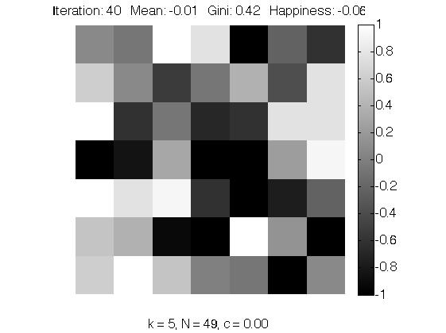
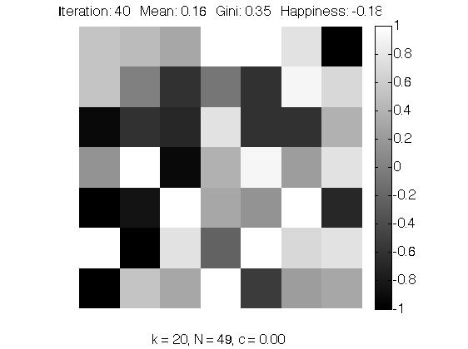
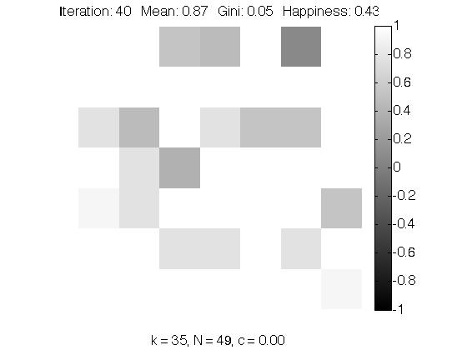
Results: Dynamic baseline model
Notes:
Milan
In the course of our first model extension we implemented the model dynamically. As discussed before, social inequality emerges.
These graphs display the distribution of agents in a society. The white agents are rich and the black ones poor with shades of grey for the “middle classes”.
As in the static model, paradoxically, in the moderate mobility system, the relative share of the frustrated is highest even though mean weatlh is higher.
If we define happiness as the difference between the relative frequency of winners minus the relative frequency of losers, happiness is lowest in the moderate mobility system.

Slide 9
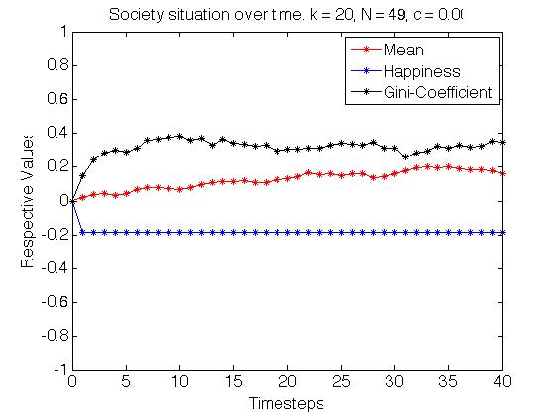
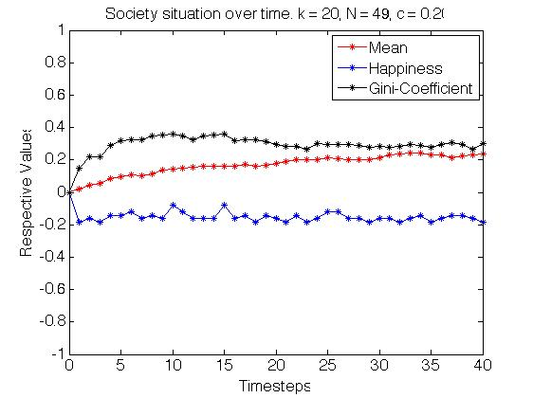
Results: Extended dynamic model with class-specific decisions
Notes:
Milan
These graphs represent the rates of investors, losers, and winners over the iterations.
On the left side, results from the static baseline model are displayed while the graph on the right side displays results from the dynamic baseline model.
It becomes evident that class specific investment behaviour dampens the increase in relative frustration and thus lead to a higher average happiness.
We refer to this as second-order Tocqueville paradox.

Slide 10
Results: Summary
Social improvements may lead to more aggregate frustration due to over-investment (Tocqueville paradox).
Social inequality in combination with class-specific decision behaviour may dampen the increase in aggregate frustration (Second-order Tocqueville paradox).
Mechanism:
Core problem of basic model: Over-investment.
Extended model produces more risk-aversive losers than risk-seeking winners.
In a subsequent round, the former losers are prevented from losing again.
This increases the former winners’ chances of winning again.
→ Increase in average happiness.
Notes:
Nick
The main implication of the basic model is that social improvements may lead to more frustration due to over-investment. This is called Tocqueville‘s paradox and is known from former studies.
Our model extension demonstrates that social inequality in combination with class-specific decision behaviour may dampen the Tocqueville paradox of an increase in aggregate frustration under improving conditions.
We refer to this as second-order-Tocqueville paradox.
How is the second order Tocqueville paradox brought about?
The core problem is that the competition structure in the baseline model produces an over-investment. In the extended model however, the competition produces more risk-aversive losers than risk seeking winners.
The losers abstain from investing and will not get frustrated again.
This leads to higher chances of winning for the remaining investors.
As a result, average happiness increases.

Slide 11
Conclusions and outlook
But: every mechanism hindering over-investment will do the trick
→ No need for politics to foster social inequality.
Real life example: grades prevent inflation of educational certificates
More elaborated models could be used to inform institutional design
Preventing a waste of resources, optimising aggregate happiness.
Notes:
Nick
What would be a policy recommendation?
There are better mechanism for preventing Tocqueville‘s paradox than fostering social inequality.
A real-life example are grades. Only individuals with high grades get access to university and this prevents an inflation of university certificates
Extended models could be used to inform institutional design in order to prevent a waste of resources and optimising aggregate satisfaction.

Slide 12
Thank you for your attention.
Boudon, R (1982). The Unintended Consequences of Social Action. London.
Coleman J (1990). Foundations of Social Theory. Cambridge (MA).
Breen, R, Goldthorpe, J (1997). Explaining Educational Differentials. Towards a Formal Rational Action Theory. Rationality and Society, 9, 275-305.
Stouffer SA, Suchman EA, Vinney LC de, Star SA, Williams RM Jr. (1965 [1949]). The American Soldier. Manhattan (Kansas).
Tocqueville A (1952 [1856]). The Old Regime and the French Revolution. New York.
Questions?
Notes:
Thank you for your attention.

